Slide 1

ENG1003 Freshman Seminar for Engineering PROJECT Design of Path Planning Algorithm for Aircraft Operation Group 8
Kam Ho LEUNG
Lok Hei NG
Pak Ho CHAN
Hoi Ki TSANG
Yat Chi KHIM

Slide 2
Background of Path Planning to Aviation Engineering

Slide 3

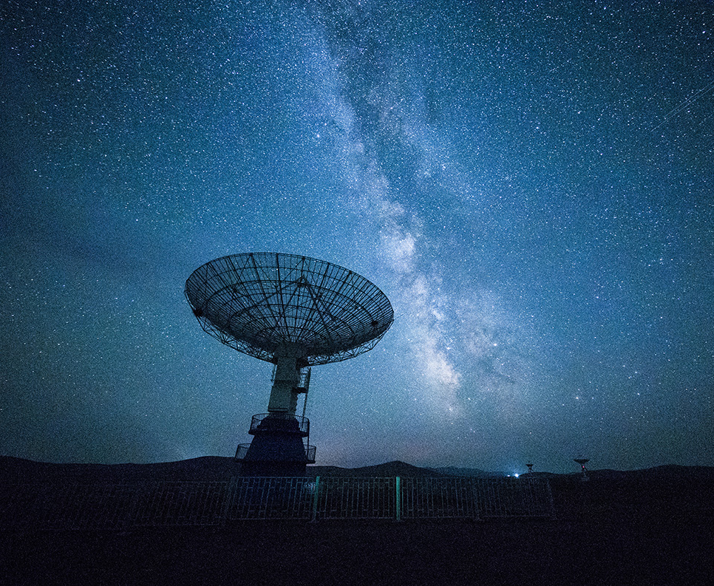
Background of Path Planning to Aviation Engineering
planning on the proposed flight route
calculate the amount of fuel needed by the aircraft
find the reasonable route
fulfil requirements of Air Traffic Control

Slide 4
Background of Path Planning to Aviation Engineering
Flight Planning
weather conditions
weight of the aircraft
length and altitude of the flight
rules

Slide 5
Background of Path Planning to Aviation Engineering
Well Path Planning
minimize flight cost
minimize fuel consumption
Be environmental-friendly
Good safety condition

Slide 6
Theory of Path Planning Algorithm

Slide 7
PATH PLANNING
consists of two parts
creating a search space
searching the best path

Slide 8
PATH PLANNING
Motion – as path in a configuration
The configurations can be represented by
different numbers of parameters
depends on the shape of the object
dimension of workspace

Slide 9
PATH PLANNING
A* is commonly used to search the shortest path to pass through
completeness
optimal efficiency
Formula of total costs of each neighbouring node
𝑓(𝑛)=𝑔(𝑛)+ℎ(𝑛)
where 𝑛 is the next node on the path

Slide 10
Introduction of the Engineering Tools - Python - GitHub

Slide 11
Python
interpret
handled by the interpreter
Interacting
write code and interact directly
object-oriented
support object-oriented styles and programming techniques

Slide 12
Most common programming language
easy to learn
few keywords, simple structure and clear syntax
easy to read
code is clearly defined and visible to the eyes
easy to maintain
source code is easy to maintain
good language for entry-level programmers
supports the development of various applications

Slide 13
Github
Github provides
hosting for software development and version control using Git
distributed version control of Git and source code management functions
access control and multiple collaboration functions

Slide 14
Github
Five essentials
Repositories
Branches
Commits
Pull requests
Git

Slide 15
Trip cost
C = 𝐶𝐹 ∙ ∆𝐹 + 𝐶𝑇 ∙ ∆𝑇 +𝐶𝑐
𝐶𝐹=cost of fuel per kg
𝐶𝑇=time related cost per minute of flight
𝐶𝑐=fixed cost independent of time
𝐶𝑇=time related cost per minute of flight
∆𝐹=trip fuel
∆𝑇=trip Time

Slide 16
Task 1: Finding the PolyU Aircraft Model
that achieve the minimum cost

Slide 17
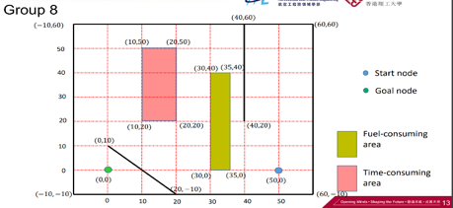
The polyu aircraft models
Aircraft Model | CF | ∆𝐹 | 𝐶𝑇 | ∆𝑇 | 𝐶𝑐 | ∆𝐹a | ∆Ta
PolyU-A380 | 1 | 1 | 2 | 5 | 10 | 0.2 | 0.2
PolyU-A381 | 1 | 1.5 | 3 | 5 | 10 | 0.3 | 0.4
PolyU-A382 | 1 | 2.0 | 4 | 5 | 10 | 0.4 | 0.5
PolyU-A383 | 1 | 2.5 | 5 | 5 | 10 | 0.5 | 0.1
Figure 1, the map given for task 1.

Slide 18

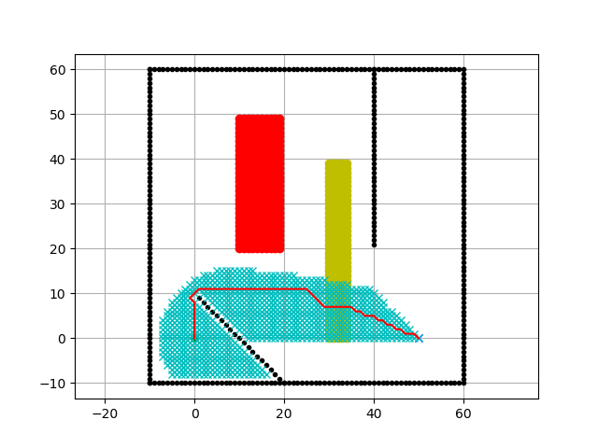
TASK 1
PolyU-A380| 1 | 1 | 2 | 5 | 10 | 0.2 | 0.2 | re:1382.7787873376903

Slide 19

TASK 1
PolyU-A381| 1 | 1.5 | 3 | 5 | 10 | 0.3 | 0.4 | re:1745.6732316404184

Slide 20

TASK 1
PolyU-A382| 1 | 2.0 | 4 | 5 | 10 | 0.4 | 0.5 | re:2108.067675943146

Slide 21

TASK 1
PolyU-A383| 1 | 2.5 | 5 | 5 | 10 | 0.5 | 0.1 | re:2467.9621202458734

Slide 22
Task 2.1: Finding the PolyU Aircraft Model that
achieve the minimum cost
(4 constraints with 2 variables)
∆F | ∆T | Cc | ∆Fa | ∆Ta5
5 | 5 | 10 | 5 | 5

Slide 23
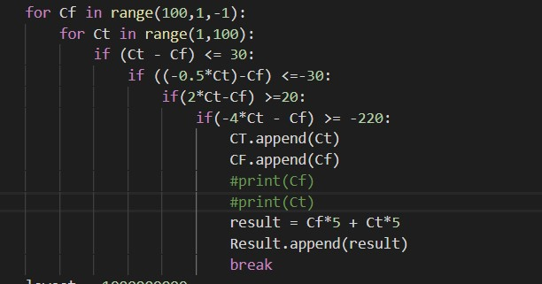
Methodology
2 for loop
- Cf from range 100 to 1
- Ct from 1 to 100
loop will break when both of the Cf and Ct fulfill those constraints

Slide 24
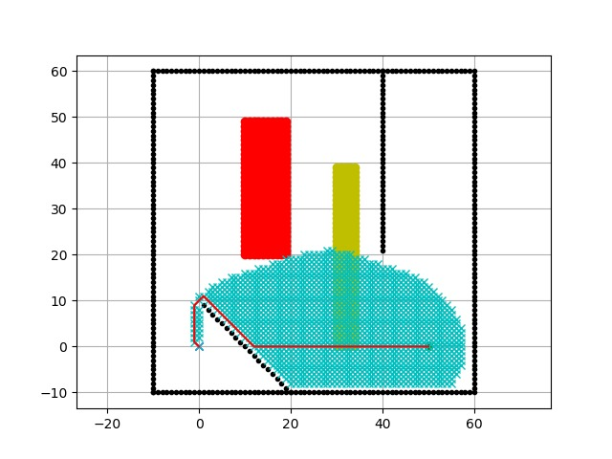
TASK 2.1
When Cf =20 Ct=20
Find goal with cost of -> 13842

Slide 25
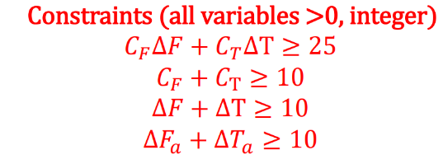
Task 2.2: Finding the PolyU Aircraft Model that
achieve the minimum cost
(4 constraints with 6 variables)
Figure 13

Slide 26
TASK 2.2
Cf | ∆F | Ct | ∆T | Cc | ∆Fa | ∆Ta
16 | 1 | 1 | 9 | 10 | 1 | 9
Cost Per Grid for the current configuration: 35
Find goal with cost of -> 2307.9646455628163

Slide 27
Task 3: Designing a new cost area that can reduce the
cost of the route

Slide 28
Methodology
Generate a path without a minus-cost area
14 grid points which connected with 2 slopes

Slide 29
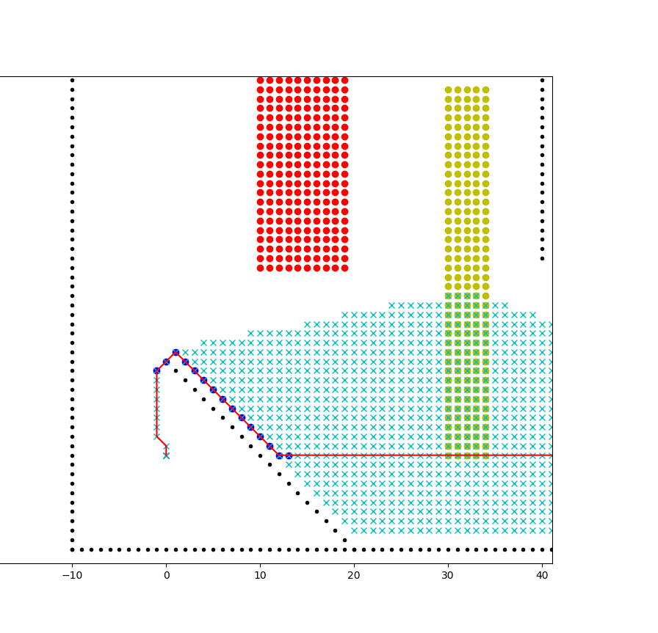
TASK 3
Cost Per Grid for the current configuration: 21
Find goal with cost of -> 1259.5828278447962
Aircraft Model | CF | ∆F | CT | ∆T | Cc | ∆Fa | ∆Ta | Cp | ∆P
PolyU-A380 | 1 | 1 | 2 | 5 | 10 | 0.2 | 0.2 | -2 | 5

Slide 30

THANK YOU

